Slide 1


Slide 2
Project Overview

Slide 3

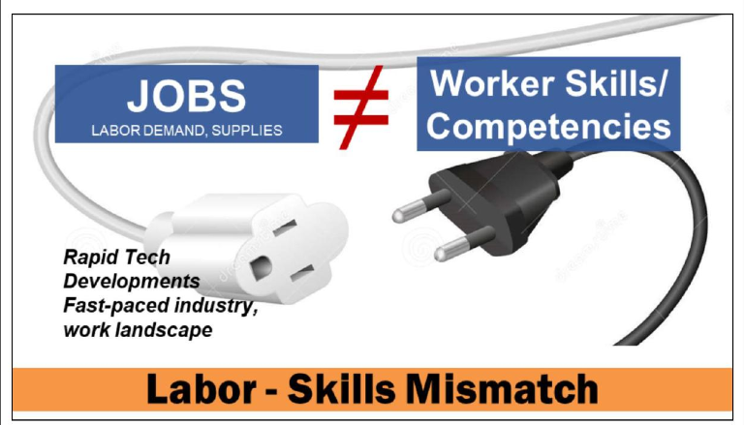

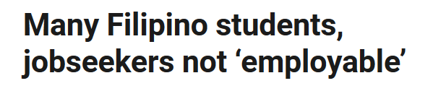

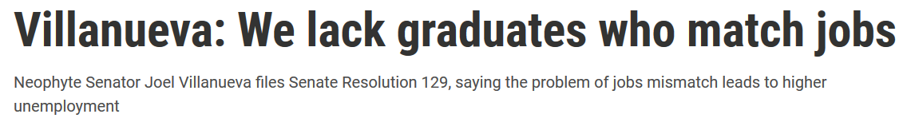
Skills Gap & Mismatch
Problem
Source: philstar.com rappler.com ecop.org.ph

Slide 4
Proposed Solution

Slide 5


Target Audience
Job Seekers
Fresh Graduates

Slide 6

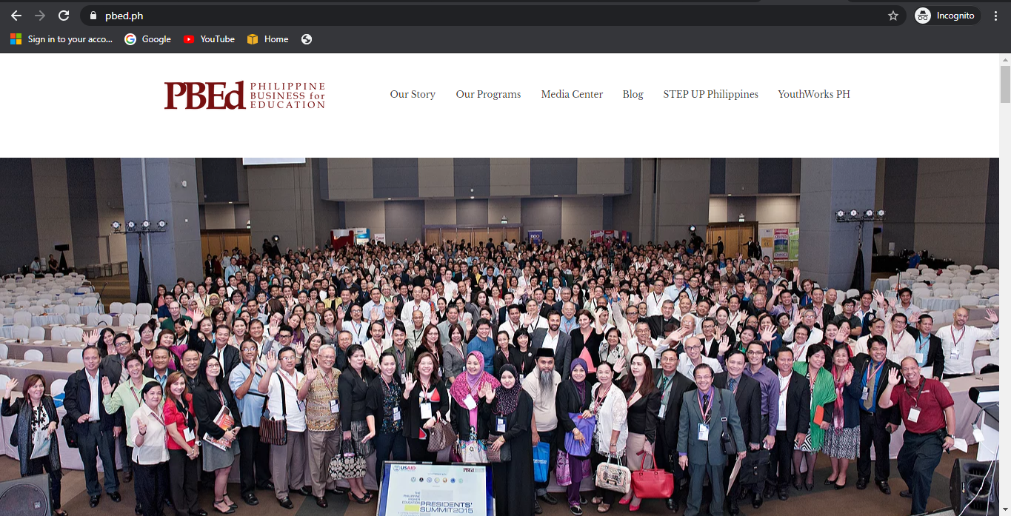

Description
Solution
Add a Service in the Existing Website of Nonprofit Organization (pbed.ph)
IBM Watson Discovery
IBM Personality Insights

Slide 7

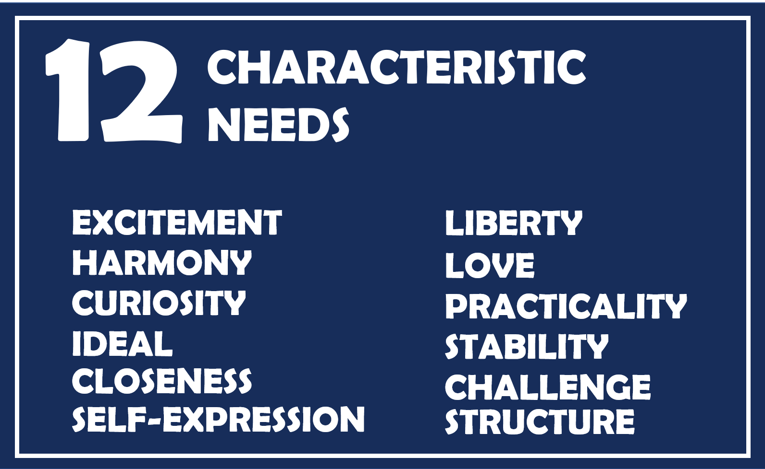
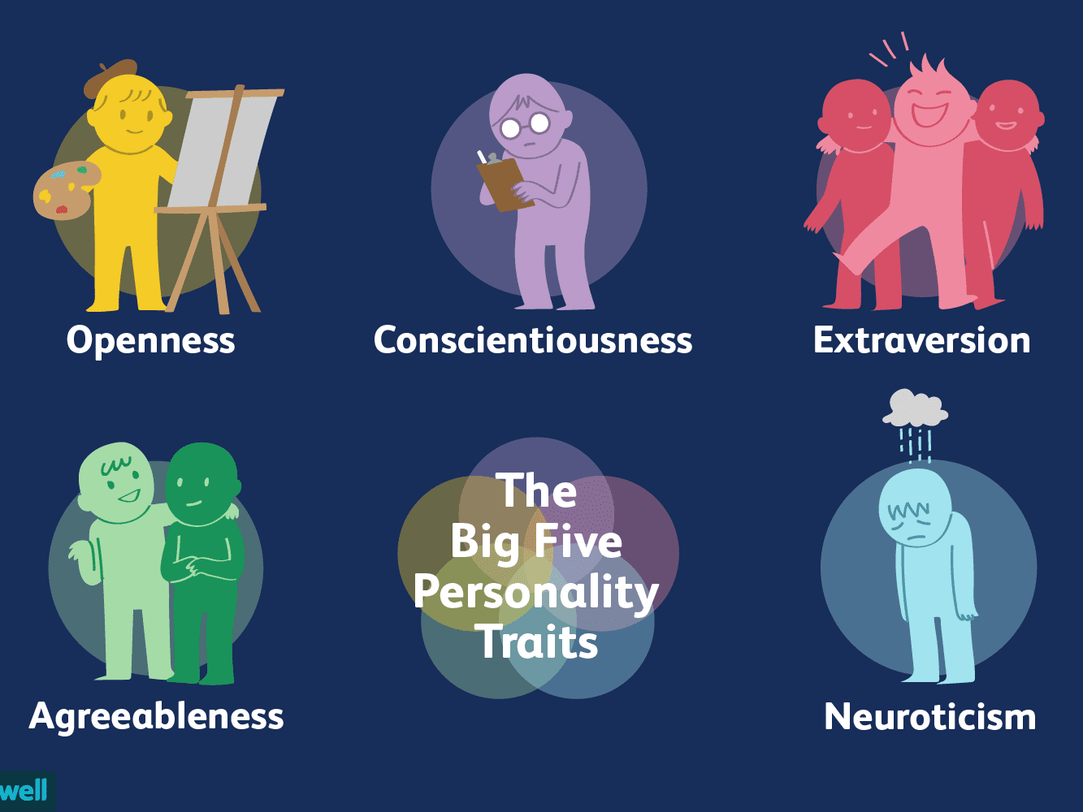
Description
Solution
Personality Insights

Slide 8



Description
Solution
Training Suggestions
Watson Discovery
Course Suggestions
Articles

Slide 9
Demo

